Slide 1
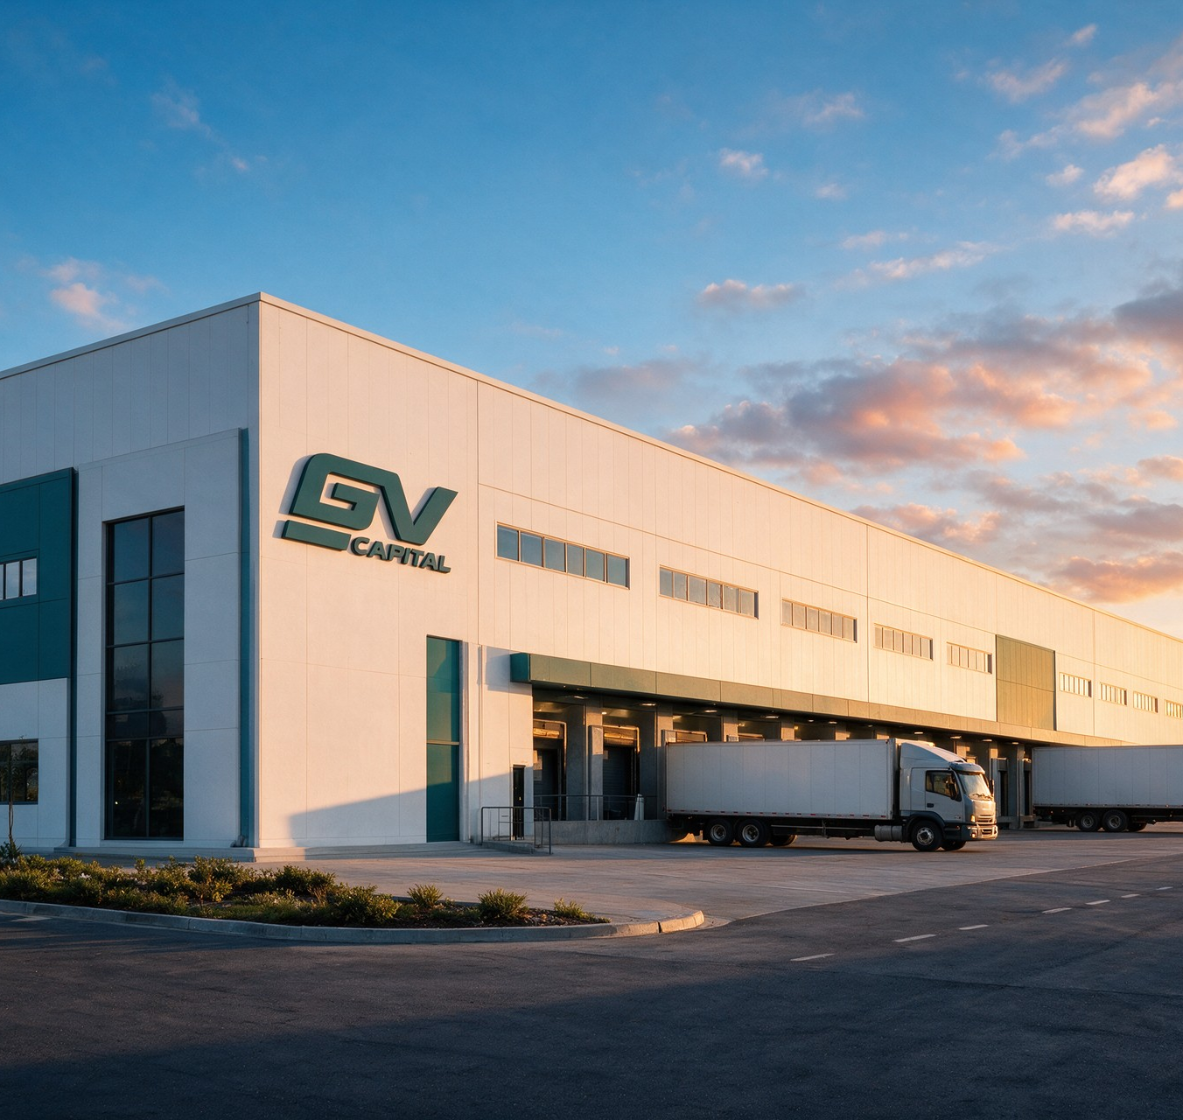


GV CAPITAL
Investment and development holding
GEORGIAN VENTURES
CONCEPT IMAGERY
Notes:
Image source: assets/gv-campus-daylight.png. Brand concept visualization, not evidence of a completed or available project.

Slide 2


The company
Space for projects,
partnerships and
development
HOLDING | INITIAL FOCUS
GV Capital Georgian Ventures | Industrial & Logistics
CONCEPT IMAGERY
GV CAPITAL
02
Notes:
Image source: assets/brand-editorial-v2/01-georgian-ventures-overhead.webp. Brand concept visualization, not evidence of a completed or available project.

Slide 3
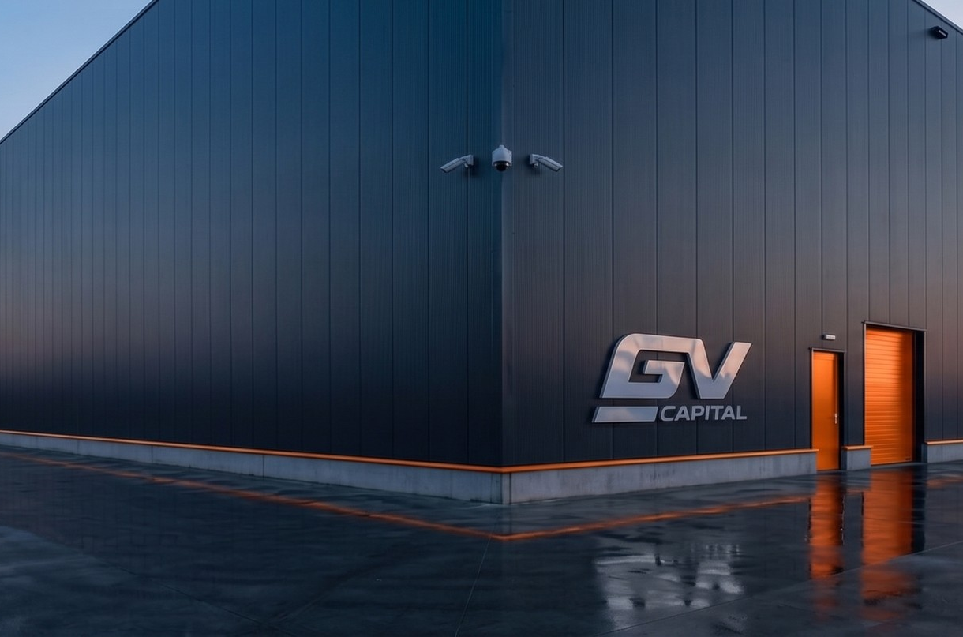
Industrial & Logistics
Production and
warehouse complexes
In Tbilisi and its surrounding area.
The holding’s first business focus.
CONCEPT IMAGERY
GV CAPITAL
03
Notes:
Image source: assets/gv-facade-wide-evidence.jpeg. Brand concept visualization, not evidence of a completed or available project.

Slide 4
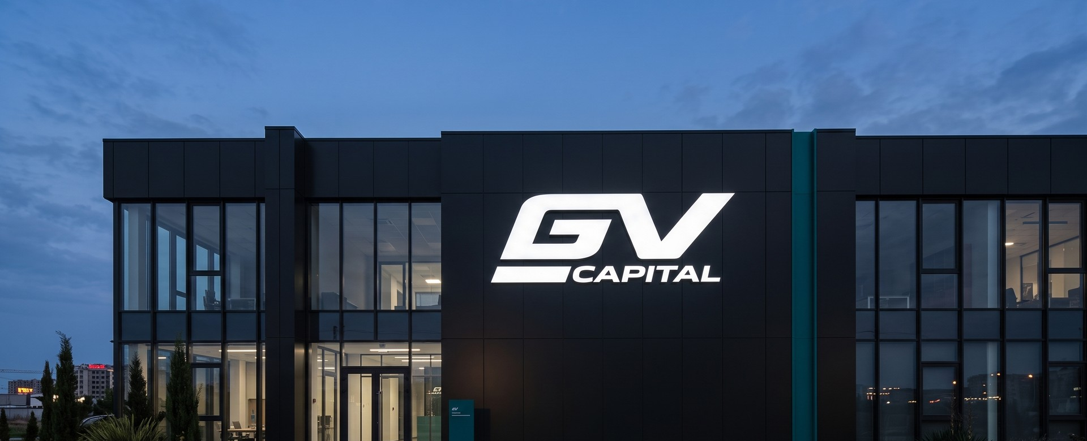
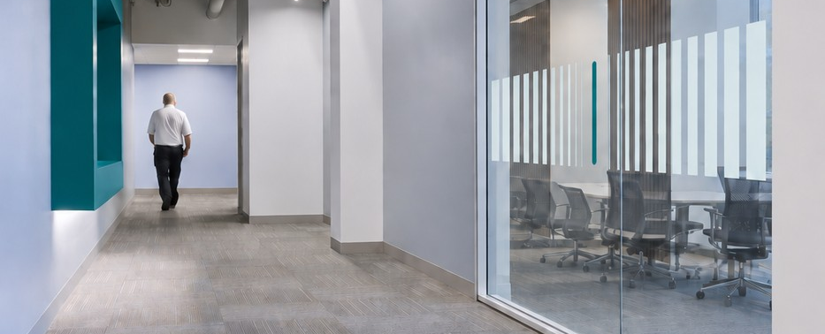
Space for business
CONCEPT IMAGERY
Entire complex
Individual block
Purchase the whole development.
Purchase a production or warehouse block within the complex.
GV CAPITAL
04
Notes:
For companies that require their own production or warehouse premises. Image sources: assets/gv-facade-mockup.jpeg and assets/gv-office-corridor-glass-field-v2.png. Both are concept visualizations.

Slide 5

Who we work with
AUDIENCE | INTEREST
Investors | Scale and measurable risk
Partners | Developers, operators, finance and construction partners
Businesses | Their own production or warehouse space
CONCEPT IMAGERY
GV CAPITAL
05
Notes:
Image source: assets/brand-editorial-v2/02-opportunities.webp. Brand concept visualization, not evidence of a completed or available project.

Slide 6
Our principles
PRINCIPLE | OUR APPROACH
Reliability | Our actions match our commitments.
Partnership | The property sale begins an ongoing relationship.
Long-term thinking | We build for use twenty years from now.
GV CAPITAL
06

Slide 7

A conversation about
your requirements
SUBJECT | STARTING INFORMATION
Intended use | Production or warehouse requirement
Scale | Required area and preferred location
Format | Purchase or partnership
CONCEPT IMAGERY
GV CAPITAL
07
Notes:
The starting point for a meeting is your business or partnership requirement. Image source: assets/brand-editorial-v2/03-clarity.webp. Concept visualization.

Slide 8
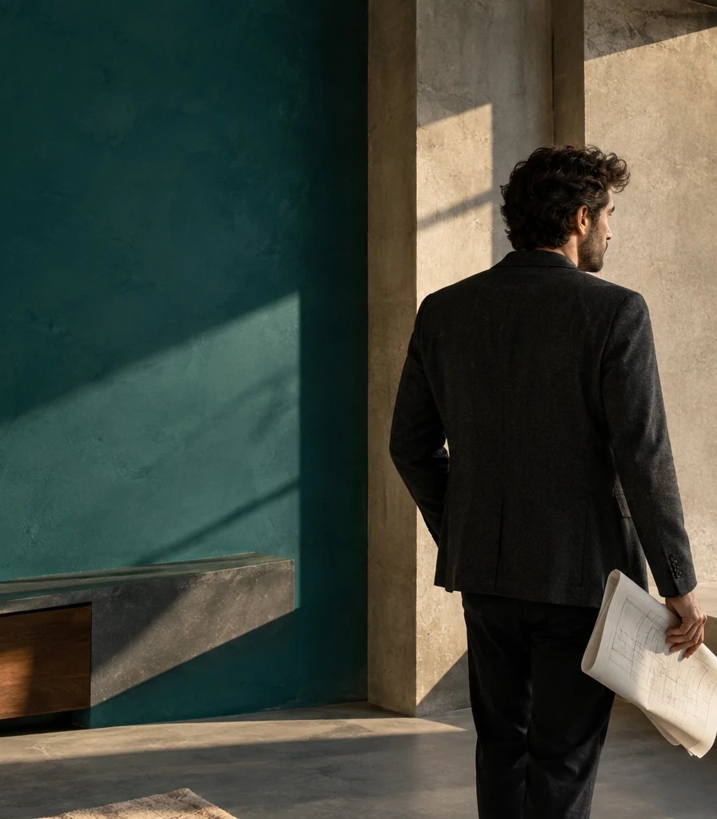
Space that
creates
opportunities
Let’s discuss your business space
or partnership.
CONCEPT IMAGERY
Notes:
GV Capital brand statement. Image source: assets/brand-editorial-v2/01-georgian-ventures.webp. Brand concept visualization.

